Slide 1


Core
150 PPV before 10th of Every Month with 500 PV Circle
WT- CEP ( Listen 1 audio/ video – 30 min/ day)
5 LCC ( Loyal Customer Club)
Do 10 Core steps on a Daily basis and Report it in Mobile App
Working Bag ( carry all Vestige, WT Tools, DEMO KIT)
Plan Show

Slide 2
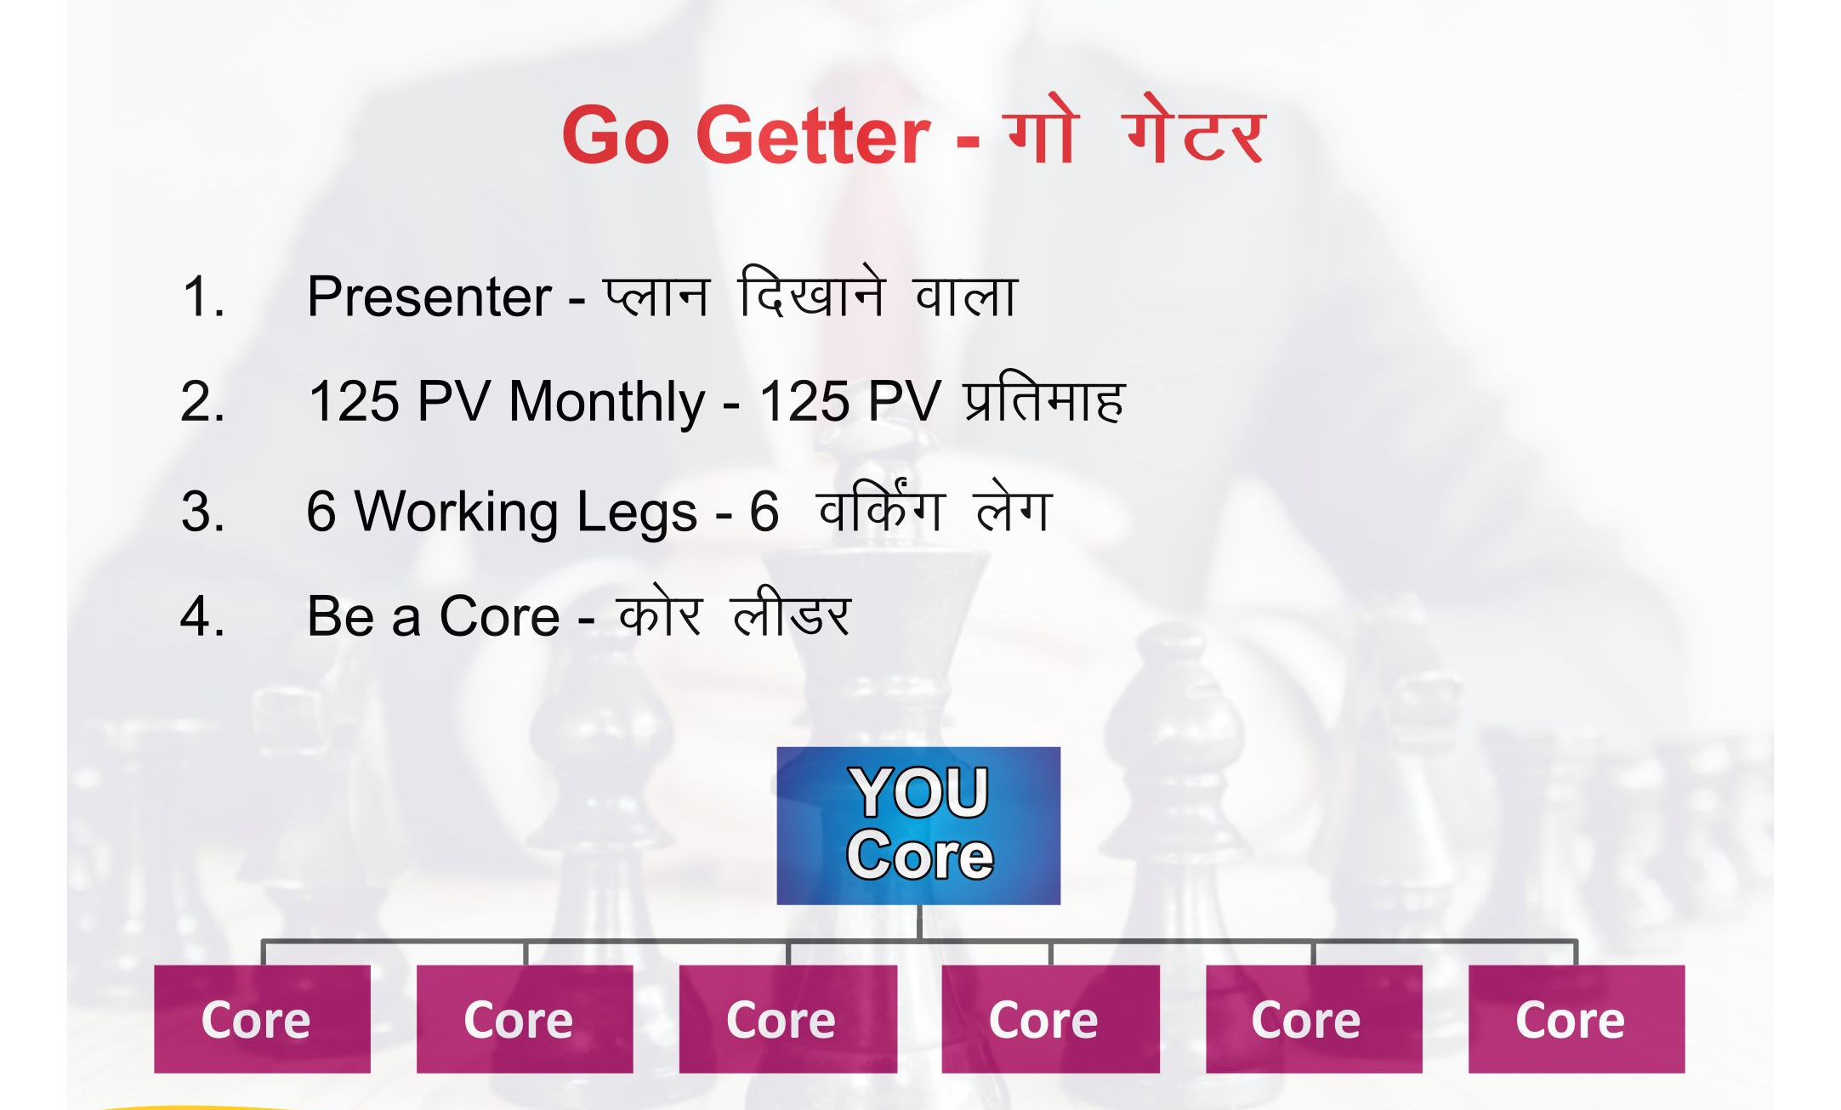
150 PV

Slide 3

Power of
500 PV CIRCLE

Slide 4
Why – 500 PV Circle
We are in turnover based business
The most important aspect of any business – sales/ volume/ Turnover
100 PV – Consumer Mindset
500 PV – Business Man Mindset
Complete 500 PV – 1st week or every Month
Maintain Customer record ( 20-30 loyal consumer), CNC
Keep Stock – 15-20 k in your House

Slide 5
Magic of 500 PV on Your Cheque
Cheque | Turnover Rs | Turnover GPV | No of 500 PV Circle Achievers In team
25 K | 3.75 lac | 12500 PV | 25 x 500
50 K | 7.5 lac | 25000 PV | 50 x 500
1 Lac | 15 lac | 50000 PV | 100 x 500

Slide 6
Create LOB
L - Life
O- Of
B – Bliss (परमानंद/ Complete Happiness)

Slide 7

3 Type of People
GREEN - NOW- Ready to take Action
YELLOW - LATER/ SOMETIME- 50-50 type
RED - NEVER - Non Performer/ Not Interested

Slide 8
How To identify the categories
Category | PAC, 500 PV CIRCLE, CORE, GO-GETTER, PASE, SELF -150 PPV
GREEN | REGULAR
YELLOW | SOMETIME
RED | NEVER

